Slide 1

CS598-Senior Design 1
Midterm Presentation
The Raiders

Slide 2
Team Composition
Majors
Andrew Johnson
Isuru Yapa
Ali Alfahdli
Julian Tee
Dallas Stroud
Electrical Engineering
Computer Science
Ali Alfadhli

Slide 3

Project:
Collision Detection Football Helmet
Ali Alfadhli

Slide 4
Why did we choose a helmet?
According to Vox.com “80% of football concussion goes unreported.”
How will the helmet benefit players?
Act as an effective safety system
Insure longer career life for athletes
High quality designed helmet that will be based on a smart tech
Ali Alfadhli

Slide 5
Market Analysis
Ali Alfadhli

Slide 6
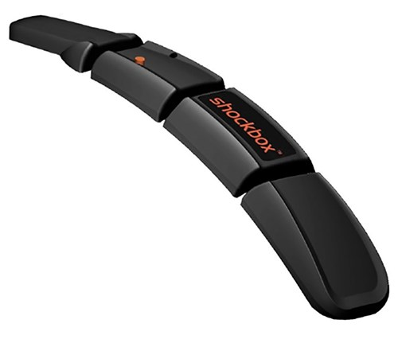
Difference between our project and Shockbox
Our project | Shockbox
Lower cost Built into the helmet Utilizes Lorawan Range of 2-3 km | High price Separate device Utilizes Bluetooth Range of 325 ft
Ali Alfadhli

Slide 7
What is a concussion?
Isuru Yapa

Slide 8
Concussion Symptoms
Physical Symptoms | Other-related symptoms
Headaches Nausea Vomiting Fatigue Blurry Vision | Confusion or feeling amnesia surrounding the traumatic event Dizziness
Isuru Yapa

Slide 9
Problem Analysis
Julian Tee

Slide 10
Concussive Impact
High School Football Athletes:
Average concussive head impact = 95 g
Lowest acceleration resulting in concussive impact = 74 g (Broglio et al, 2012)
Youth athletes (aged 9-14):
Average concussive head impact = 62.4 g
Lowest acceleration resulting in concussive impact = 25.9 g (Campolettano et al, 2019)
Julian Tee

Slide 11
Problem:
How can we differentiate severity of concussive impact?
Julian Tee

Slide 12
Solution: Creating ‘tiers’ and tier thresholds
By separating the magnitude into different tiers, we can more effectively gauge the severity of impact instead of having a binary of ‘concussion or no concussion’
Tiers
Binary
>60 g
(Check for Concussion Immediately)
No Concussion
Concussion
Detected
Severe
> 40 g
(Seek Medical Attention )
VS
Moderate
> 25 g
(Checkup after game)
No concussive impact detected
Seek Medical Attention Immediately
Minor
Note: Sample Values/Tiers only. Actual thresholds TBD
Julian Tee

Slide 13
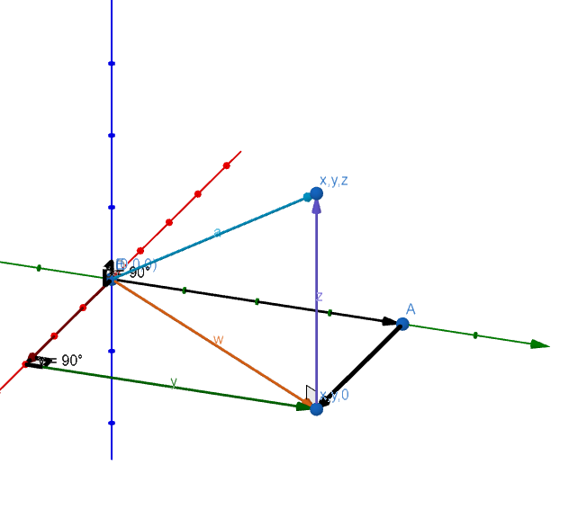
Calculating magnitude of acceleration
From the accelerometer, we obtain 𝒙, 𝐲, 𝐳 in terms of m/s²
To obtain the magnitude of a, the pythagorean theorem is used to obtain g-force as a directionless measurement as proven below:
𝒙²+𝐲²=w²
w²+𝐳²=a²
|a|=√(𝒙²+𝐲²+𝐳²)
|a|/9.81 (m/s²) = magnitude of acceleration in g’s
Julian Tee

Slide 14
Sensor/Legal/Regulations

Slide 15
Legal Analysis
RF Frequency
There are set frequency plans
There are no regulatory document
Liability/Patent
Lorawan accelerometer patent
Energy consumption
Andrew Johnson

Slide 16
Goals
•Creating a sensor that accurately records acceleration and brain waves.
•Connecting the device to a LoraWan gateway.
•Recording the data and giving to it to medical professionals.
•Integrating the device into a helmet.
Andrew Johnson

Slide 17
Bill of material
• ADXL335 will be able to be finding the dynamic force of a football hit.
•An EEG sensor that measure the humans brain waves after then it can detect for a concussion.
•Arduino uno wich connect the device to the LoraWan bridge.
Andrew Johnson

Slide 18
Software Layout
Dallas Stroud

Slide 19
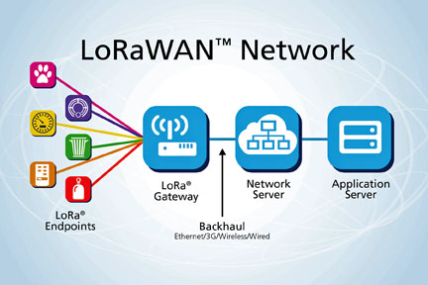
LoRaWan
Low power use
Low data bandwidth
High Connection Range
Wireless
Dallas Stroud

Slide 20
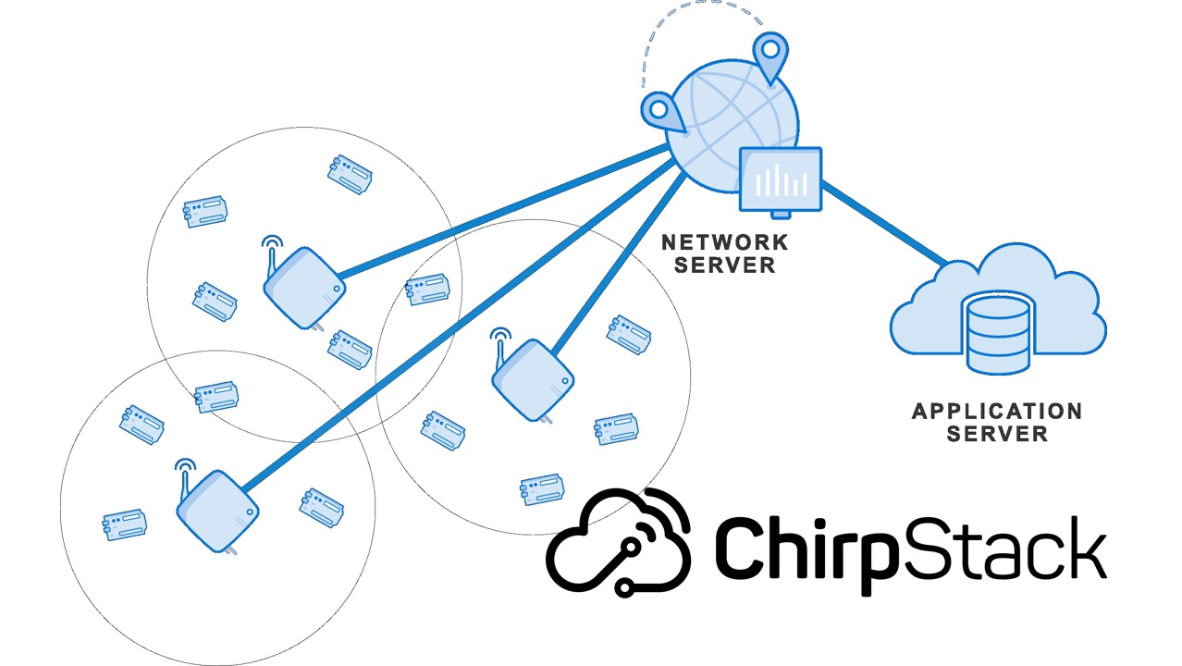
ChirpStack
Formerly known as LoRa Server
Open-Source
User Friendly
ABP vs OTAA
Dallas Stroud

Slide 21
References
Anom. “ChirpStack LoRaWAN Network Server.” Medium, 23 Jun. 2020, https://medium.com/@hendraputra/how-to-access-chirpstack-api-d9643a282c07
Broglio, S. P., Eckner, J. T., & Kutcher, J. S. (2012). Field-based measures of head impacts in high school football athletes. Current opinion in pediatrics, 24(6), 702–708. https://doi.org/10.1097/MOP.0b013e3283595616
Campolettano, E. T., Gellner, R. A., Smith, E. P., Bellamkonda, S., Tierney, C. T., Crisco, J. J., Jones, D. A., Kelley, M. E., Urban, J. E., Stitzel, J. D., Genemaras, A., Beckwith, J. G., Greenwald, R. M., Maerlender, A. C., Brolinson, P. G., Duma, S. M., & Rowson, S. (2020). Development of a Concussion Risk Function for a Youth Population Using Head Linear and Rotational Acceleration. Annals of biomedical engineering, 48(1), 92–103. https://doi.org/10.1007/s10439-019-02382-2
Yi, Jiazi. “Lora.” Advanced Communication Networks, 28 Nov. 2016, https://www.master-acn.fr/the-2016-2017-acn-m2-scientific-project-on-the-way/lora-steps-lorawan-diagram/
Stromberg, J. (2014, October 17). Study: More than 80 percent of football concussions go unreported. Vox. Retrieved October 7, 2021, from https://www.vox.com/2014/10/17/6988441/concussions.
FX, C. (n.d.). How do you know if you have a concussion? Cognitive FX. Retrieved October 7, 2021, from https://www.cognitivefxusa.com/blog/how-do-you-know-if-you-have-a-concussion.
Stein C., Meehan W. (2014) Concussion in Youth Sports. In: Micheli L., Stein C., O'Brien M., d’Hemecourt P. (eds) Spinal Injuries and Conditions in Young Athletes. Contemporary Pediatric and Adolescent Sports Medicine. Springer, New York, NY. https://doi.org/10.1007/978-1-4614-4753-5_5
Football helmet sensors - shockbox. Gridiron Tech. (n.d.). Retrieved October 8, 2021, from https://gridiron-tech.com/product/football-helmet-sensors/.

